Slide 1
Lecture 6: Data Preprocessing and Multivariate Regression
DS 4400: Machine Learning and Data Mining 1

Slide 2
Today
Today
Data Preprocessing One-Hot Encoding Normalization
Min-Max Scaling
Multivariate Regression Closed-Form Solution Multivariate Regression Practice

Slide 3
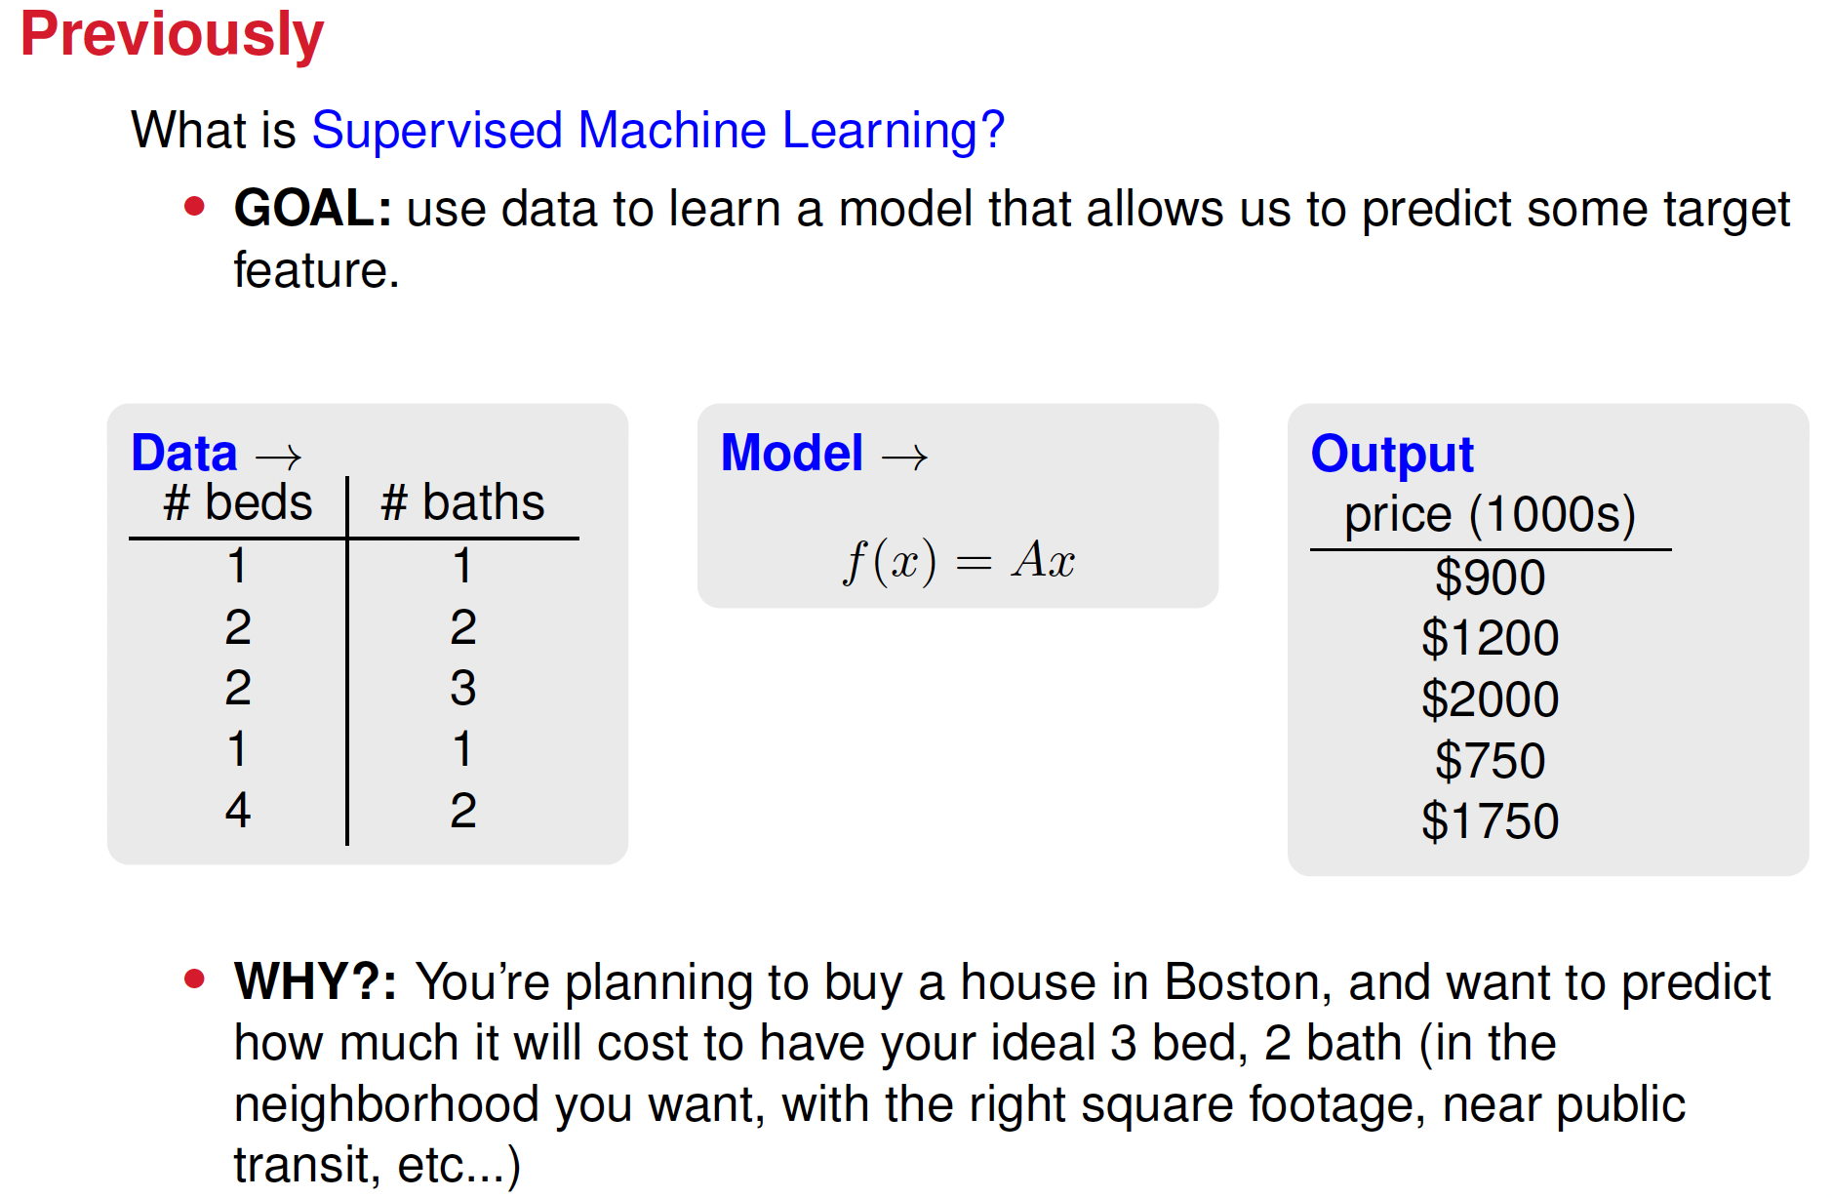

Slide 4
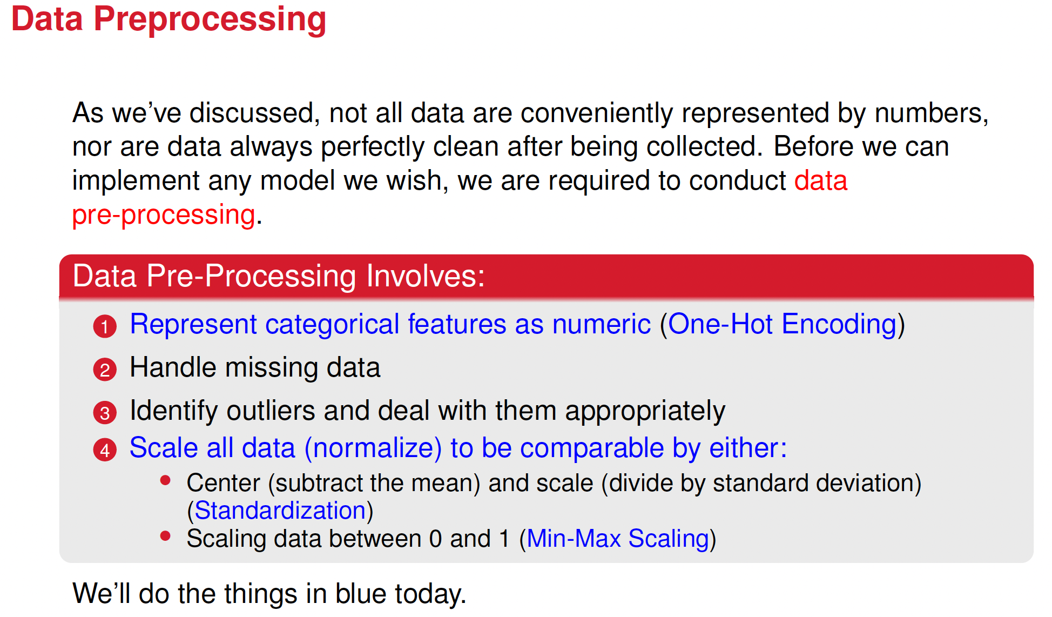

Slide 5
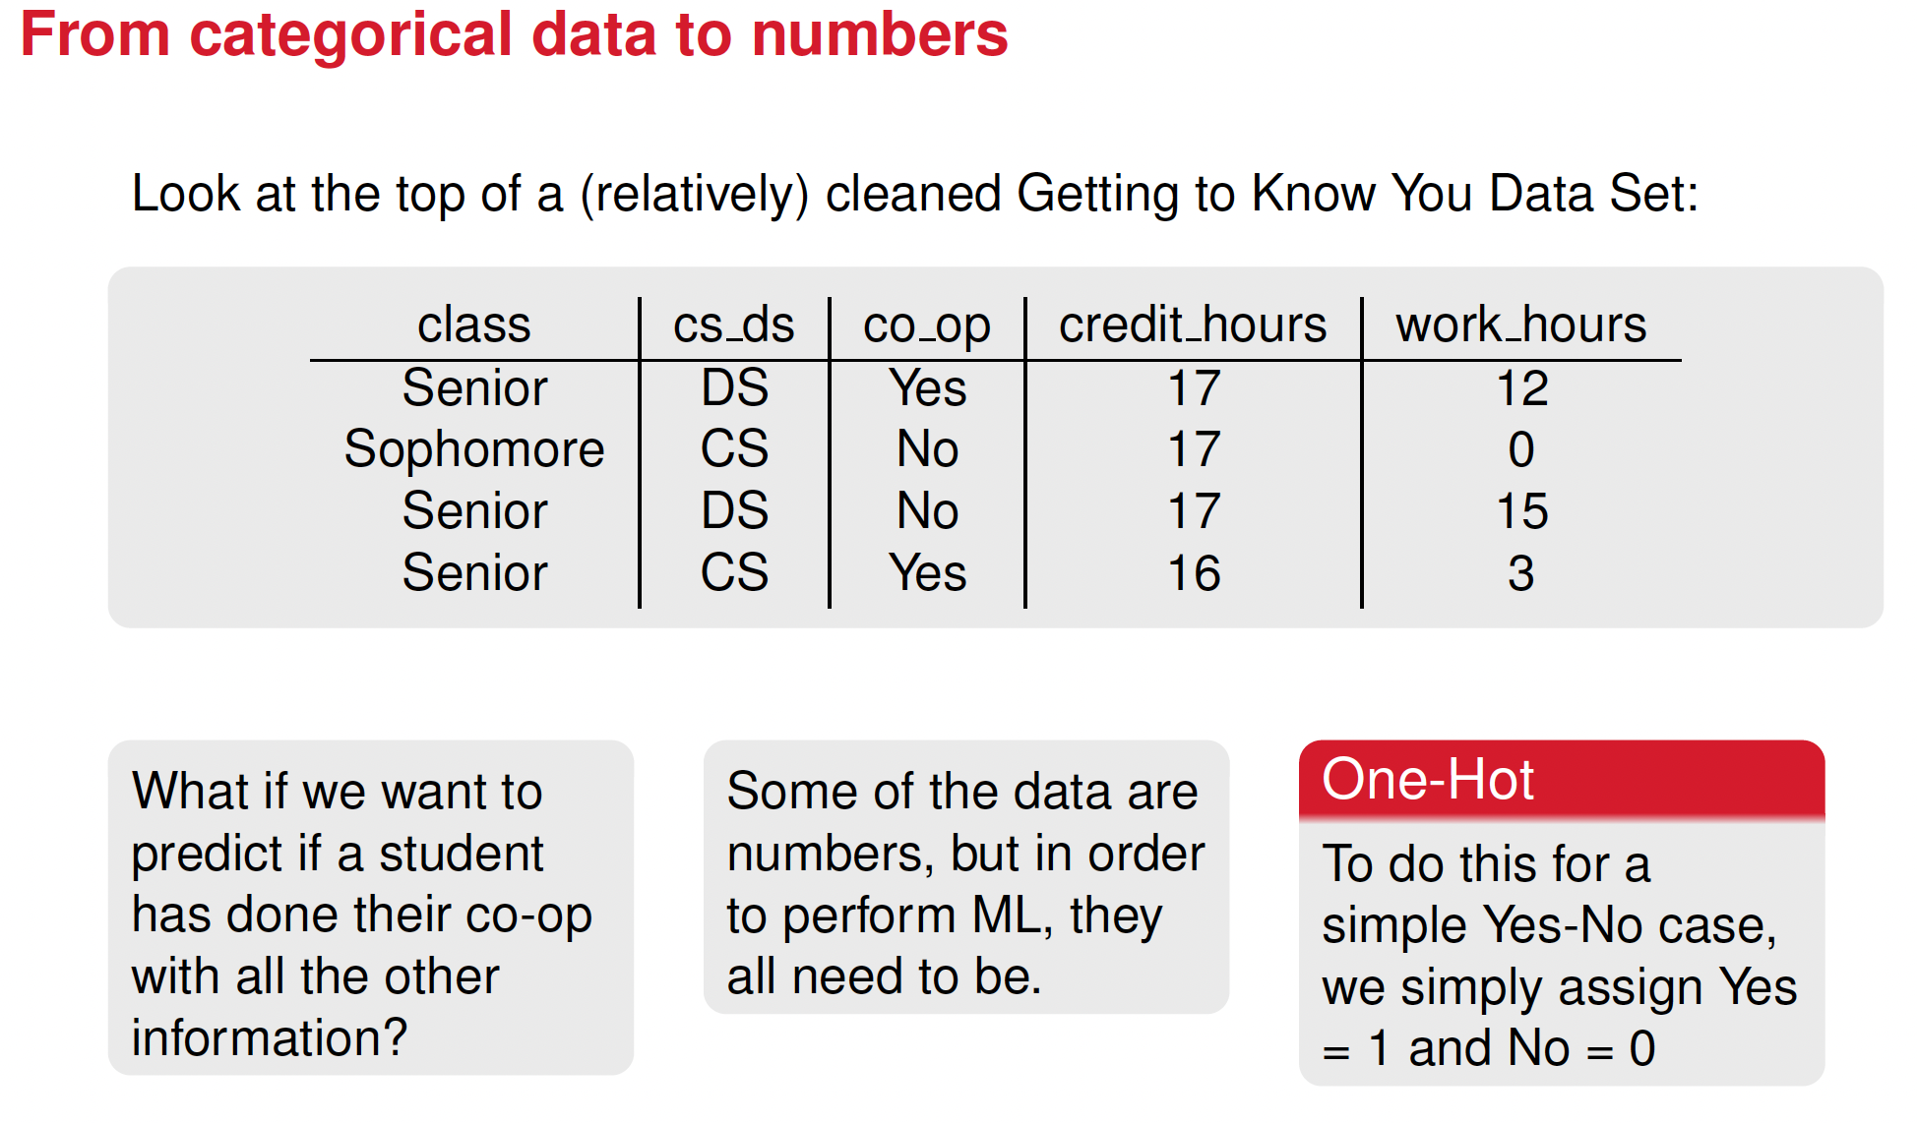

Slide 6
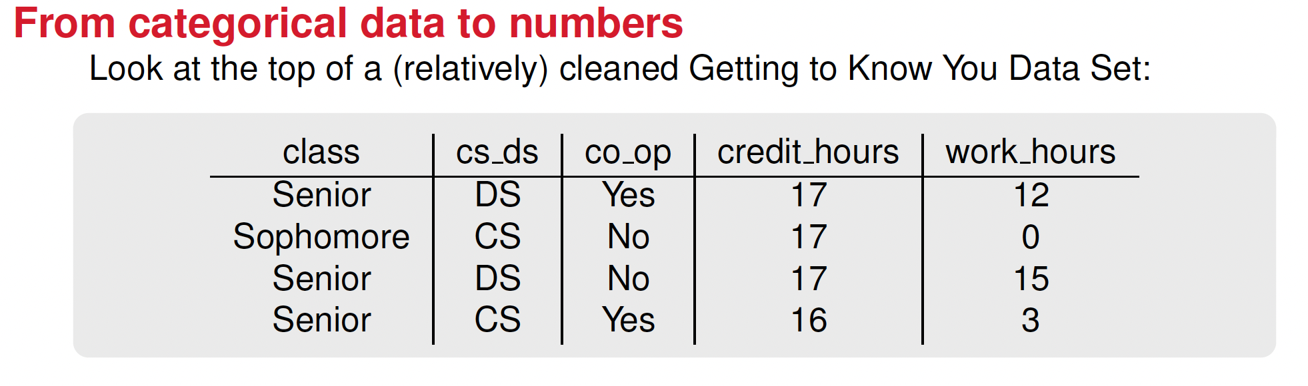
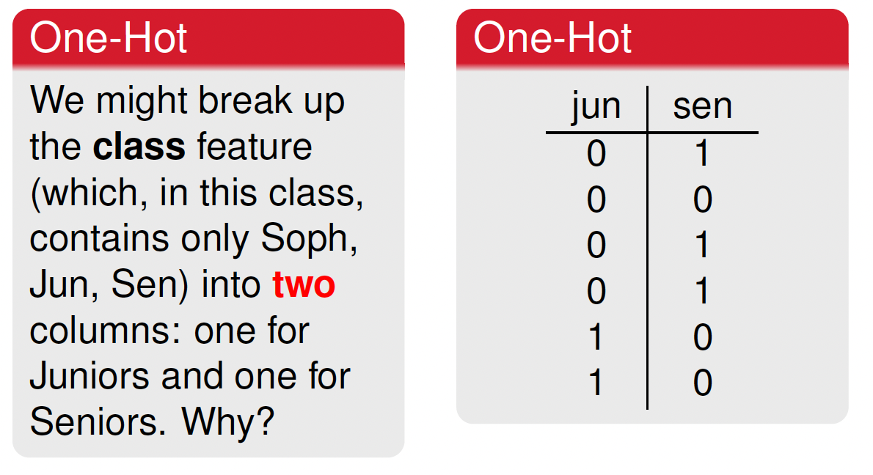
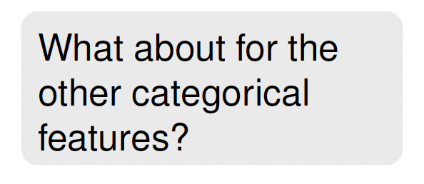

Slide 7
Why is it called one-hot encoding
The term "hot" in one-hot encoding is borrowed from electronics terminology, where a signal is considered "hot" if it is active or turned on (1), and "cold" (0).
In ML, one-hot encoding transforms categorical data into a binary vector representation
Hot value (1): Indicates the presence of a specific category.
Cold values (0): Represent the absence of all other categories.
For example, given the categories Red, Green, and Blue, one-hot encoding would look like:
Red → [1, 0, 0]
Green → [0, 1, 0]
Blue → [0, 0, 1]

Slide 8

Breakout rooms I: Practicing One-Hot Encoding in Python
Check out the data preprocess.ipynb file on Canvas to see how to take categorical features and turn them into one-hot encoded numeric features.
Pandas contains one_hot encoding

Slide 9
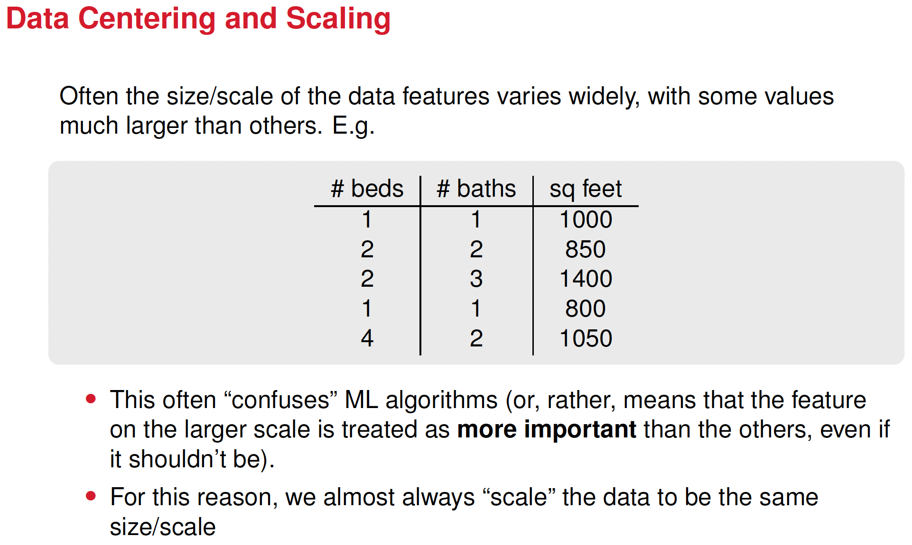

Slide 10
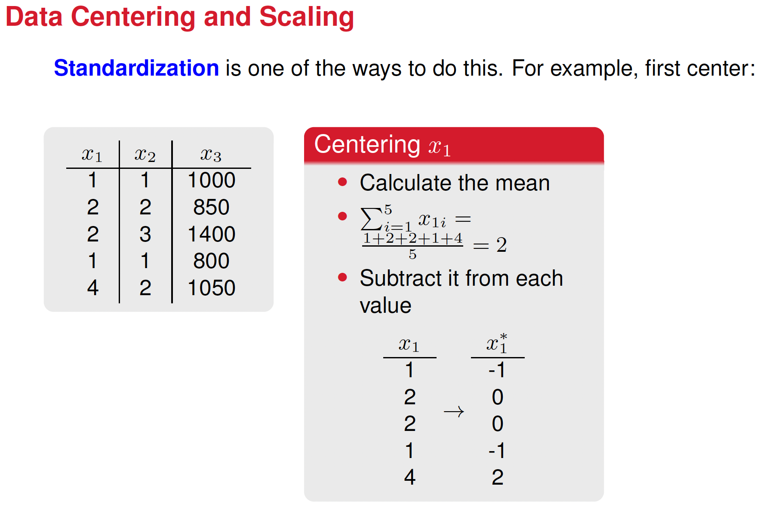






Slide 11
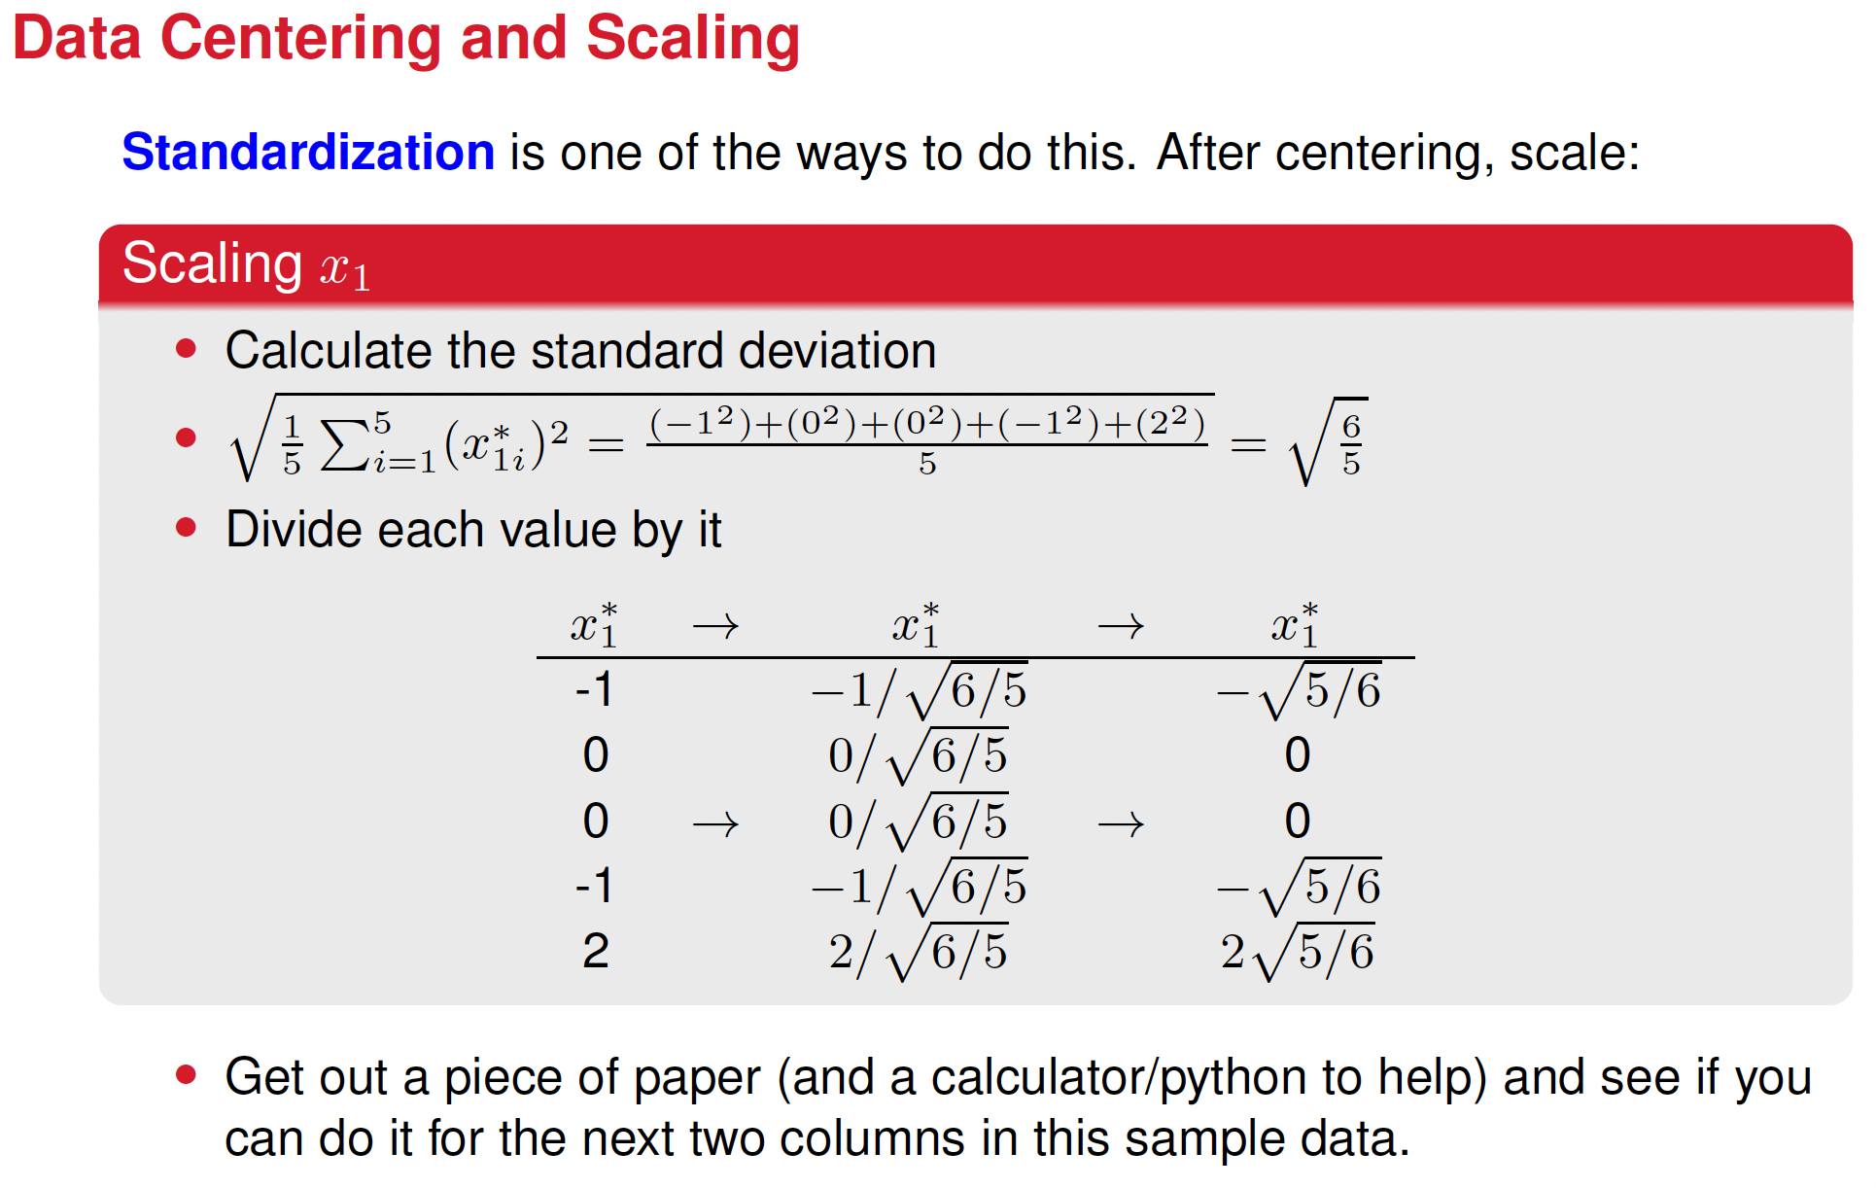

Slide 12
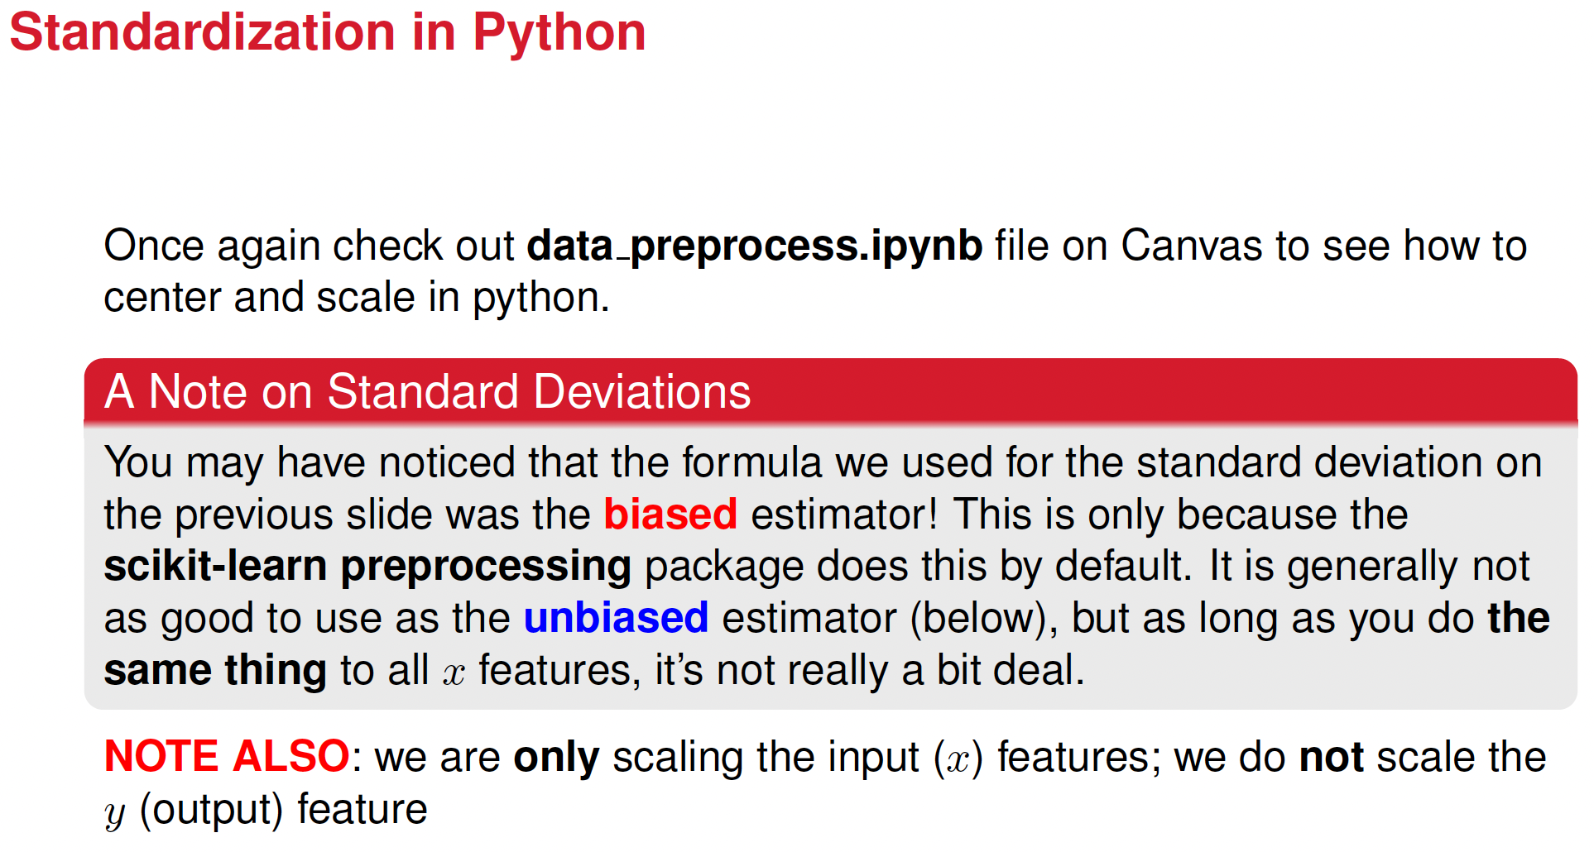

Slide 13
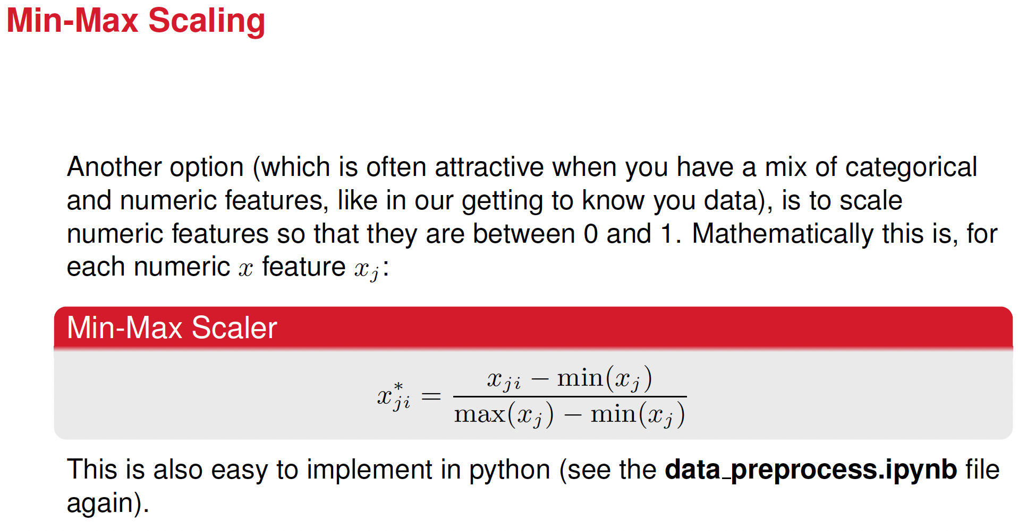

Slide 14

Breakout rooms II: Practicing standardization Python
Pick up the code data_preprocess.ipynb where you left it, and tinker with the part of the code where data centering and scaling and minmax scaling is done.
This part of the code uses sklearn

Slide 15
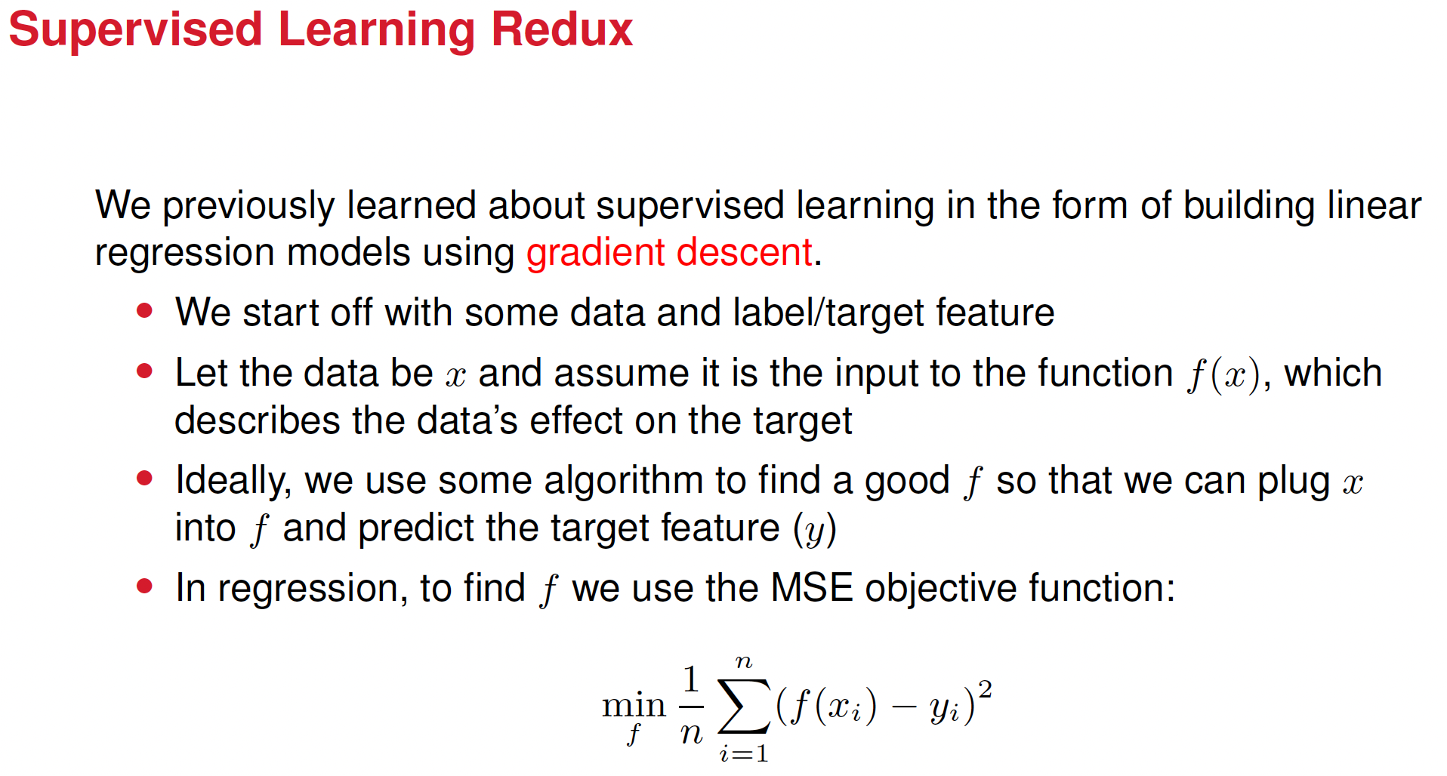





Slide 16
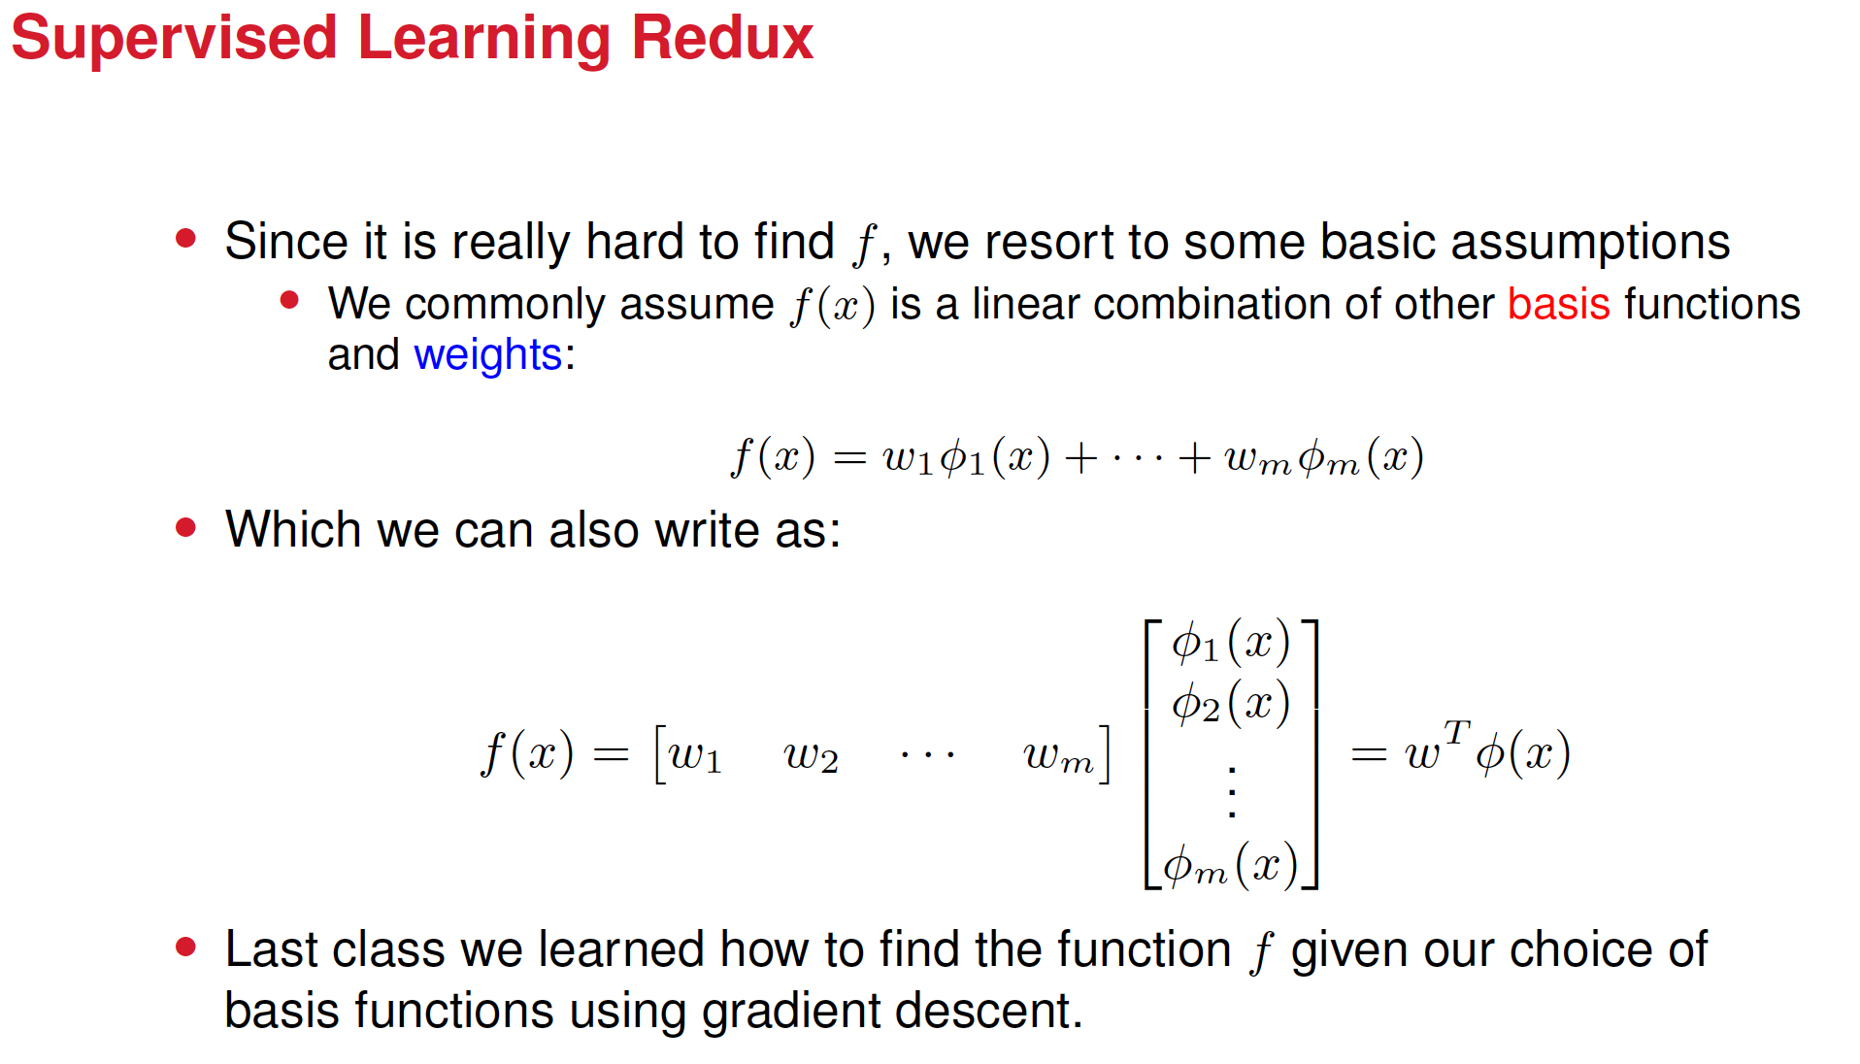



Slide 17
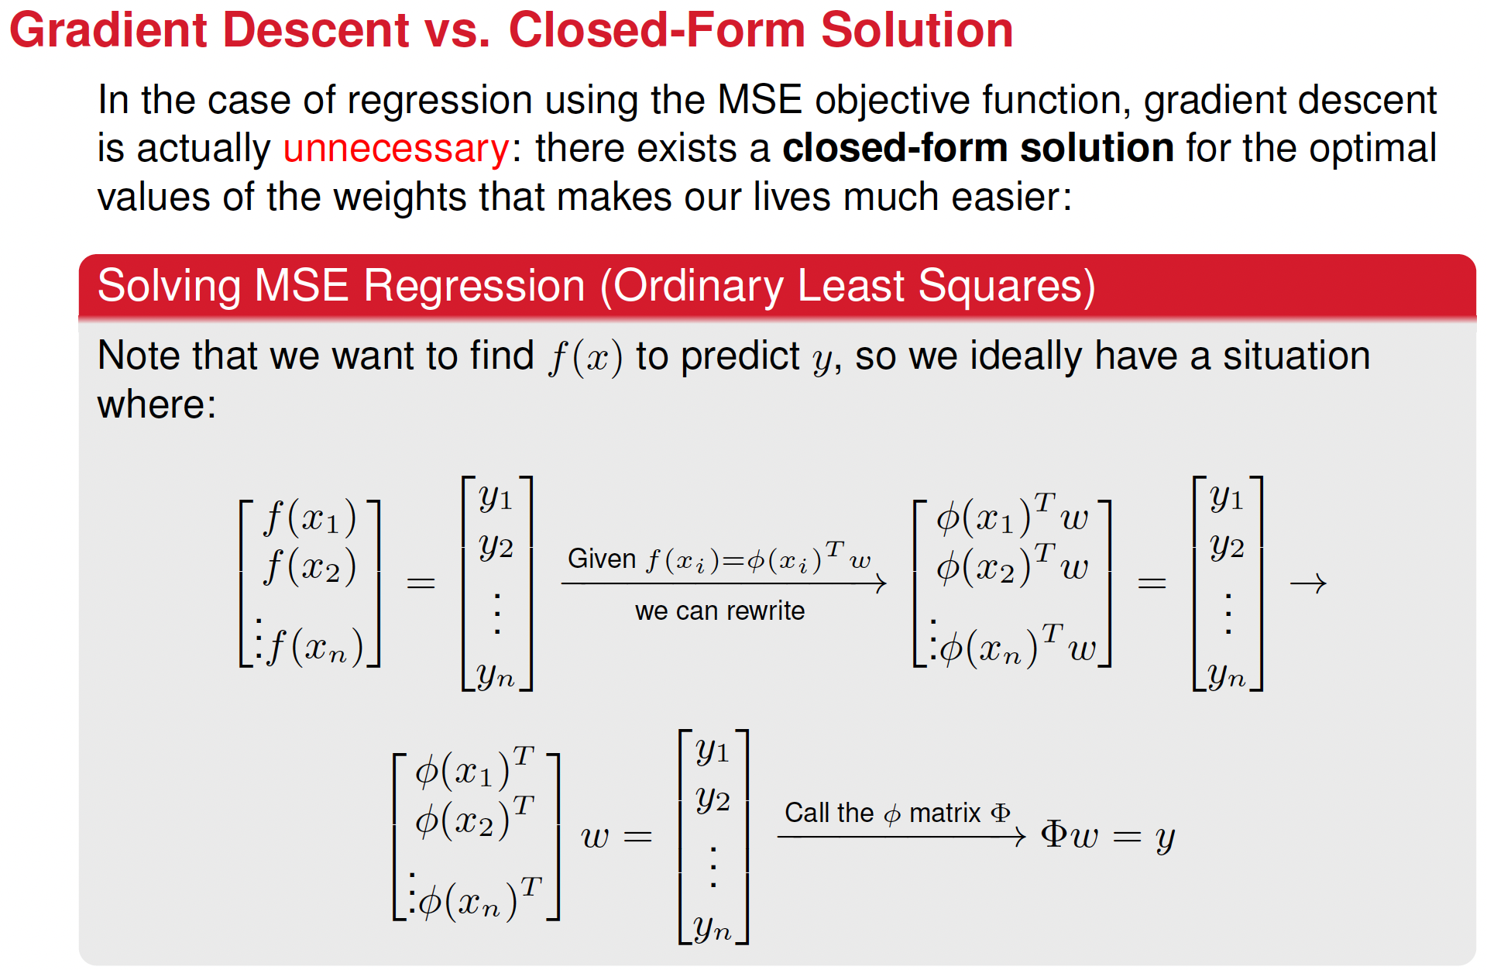



Slide 18

Uh, closed-form… What’s that?
A closed-form solution is a mathematical expression that can be evaluated in a finite number of standard operations (addition, subtraction, multiplication, division…etc.)
Closed-form solutions simplify complex problems into manageable expressions.
They provide precise answers, unlike numerical solutions, which are approximations.
Closed-form solutions reveal deeper insights into the problem, as one can observe relationships and dependencies directly.
Once derived, a closed-form solution applies universally across all cases covered by the problem, making it reusable.
Closed forms are deterministic, meaning they always produce the same result for given inputs.

Slide 19
Numerical solutions, uh?
Numerical solutions are approximate solutions to mathematical problems obtained using computational methods or algorithms instead of exact, closed-form expressions.
They are particularly useful when problems are too complex to solve analytically or when closed-form solutions do not exist.

Slide 20
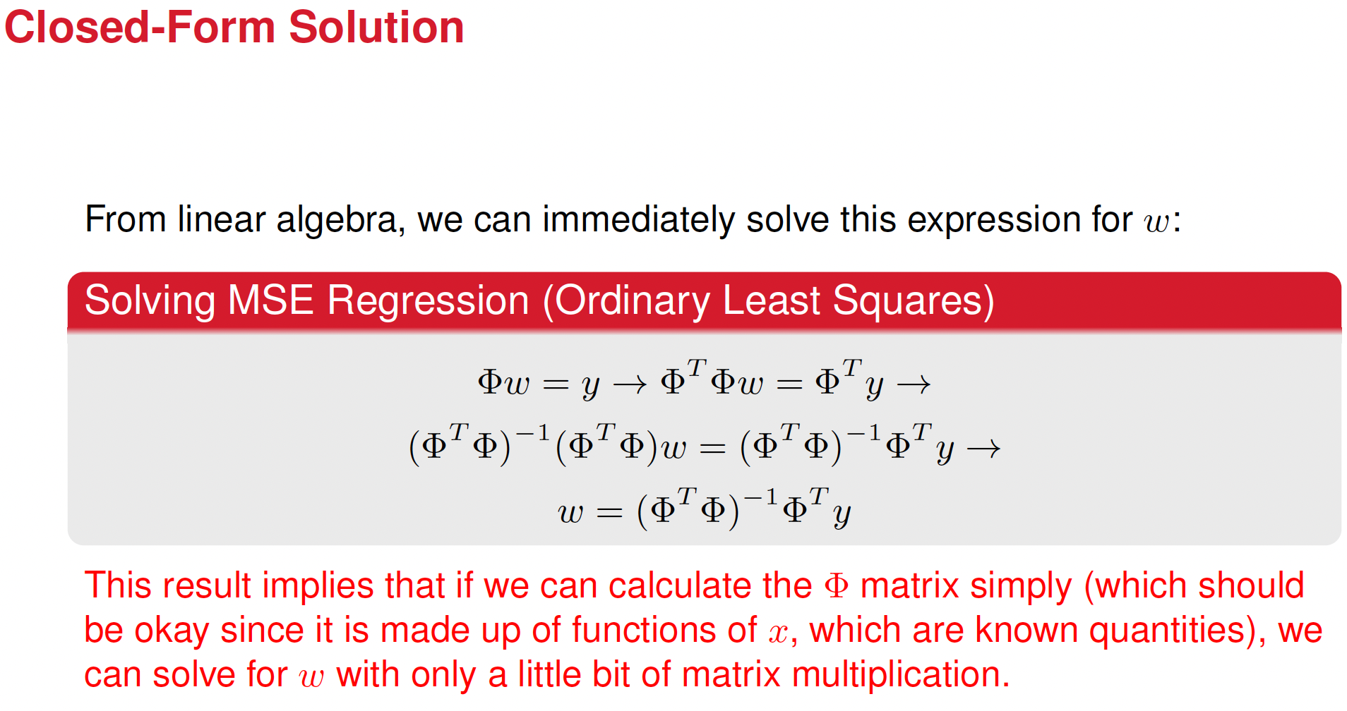







Slide 21
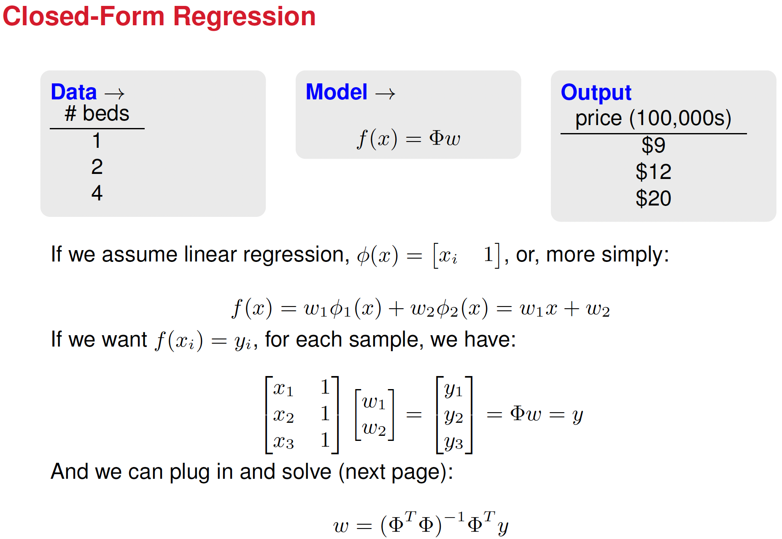
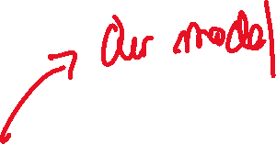


Slide 22
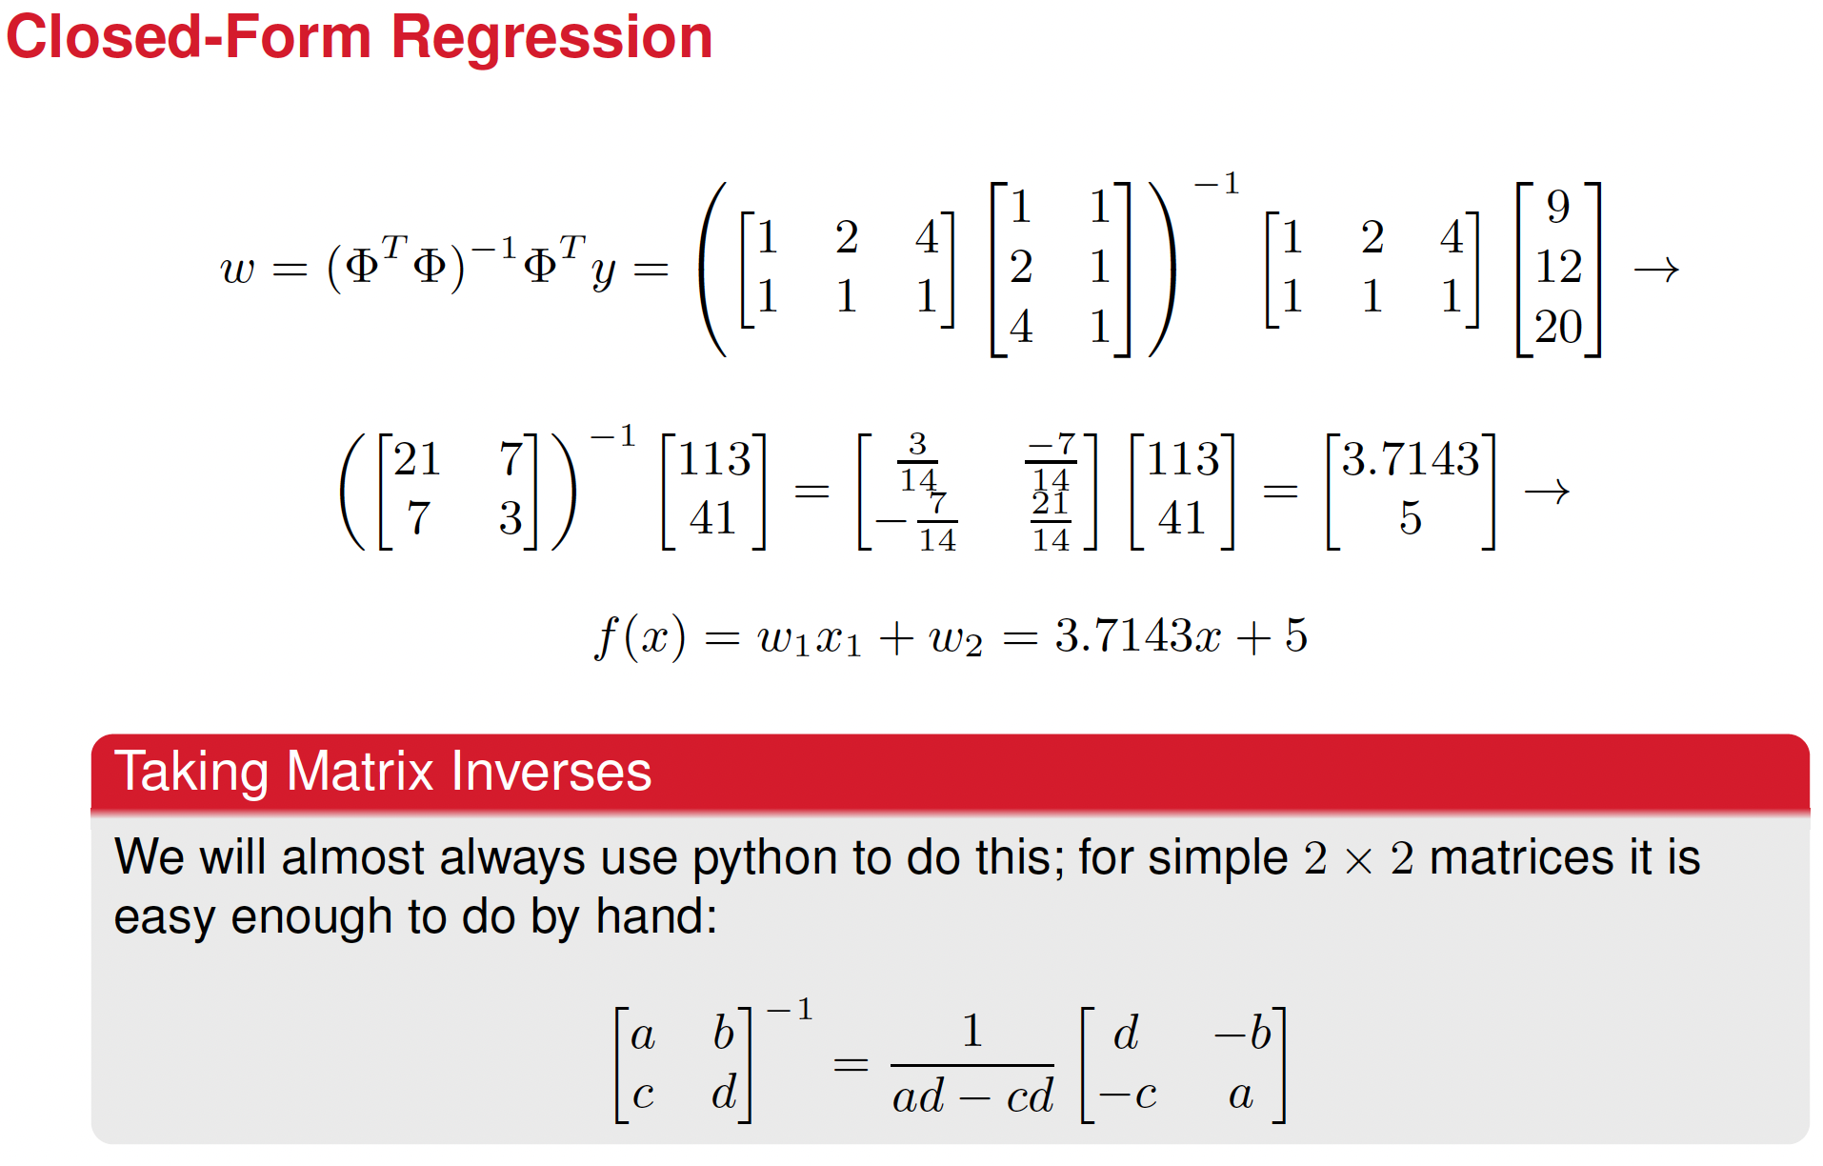

Slide 23
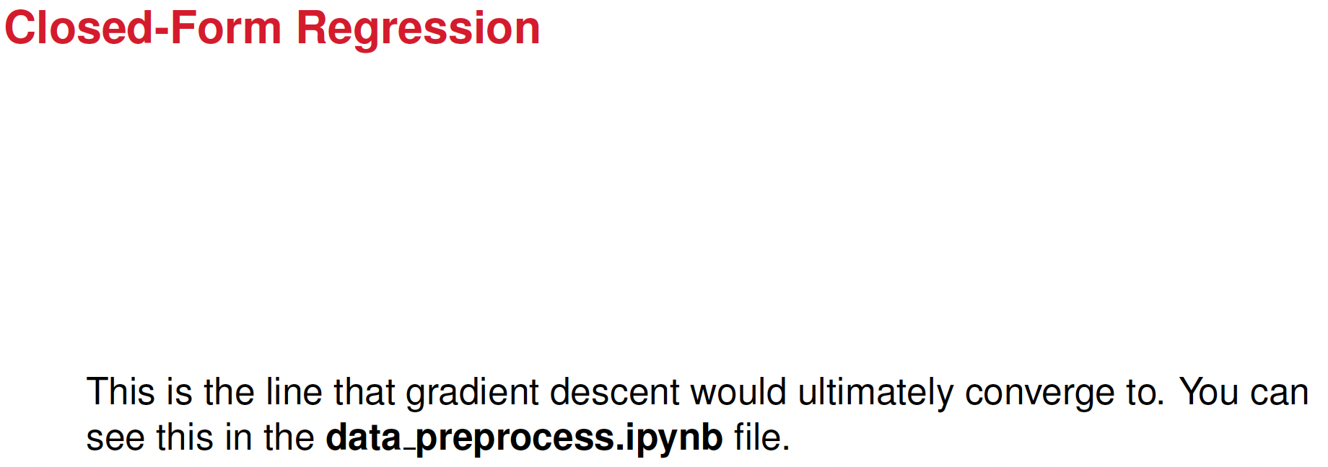
Breakout rooms III

Slide 24
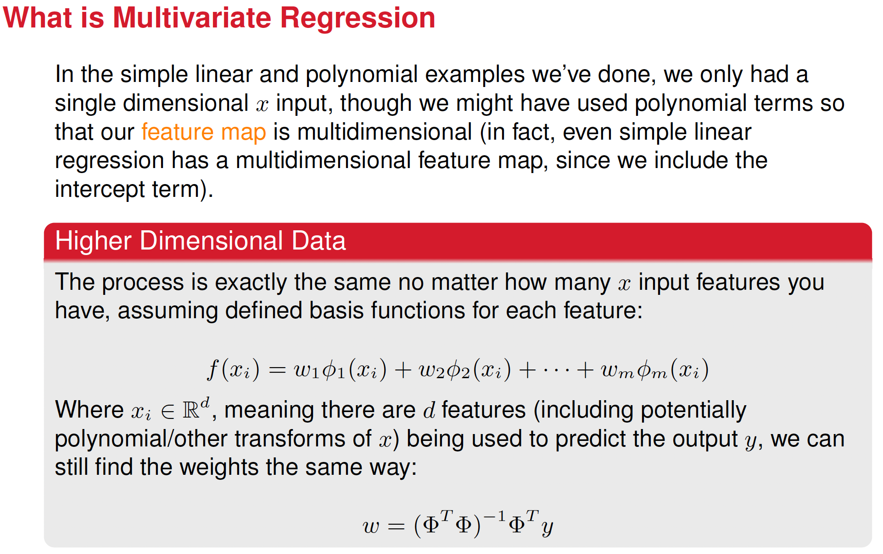

Slide 25
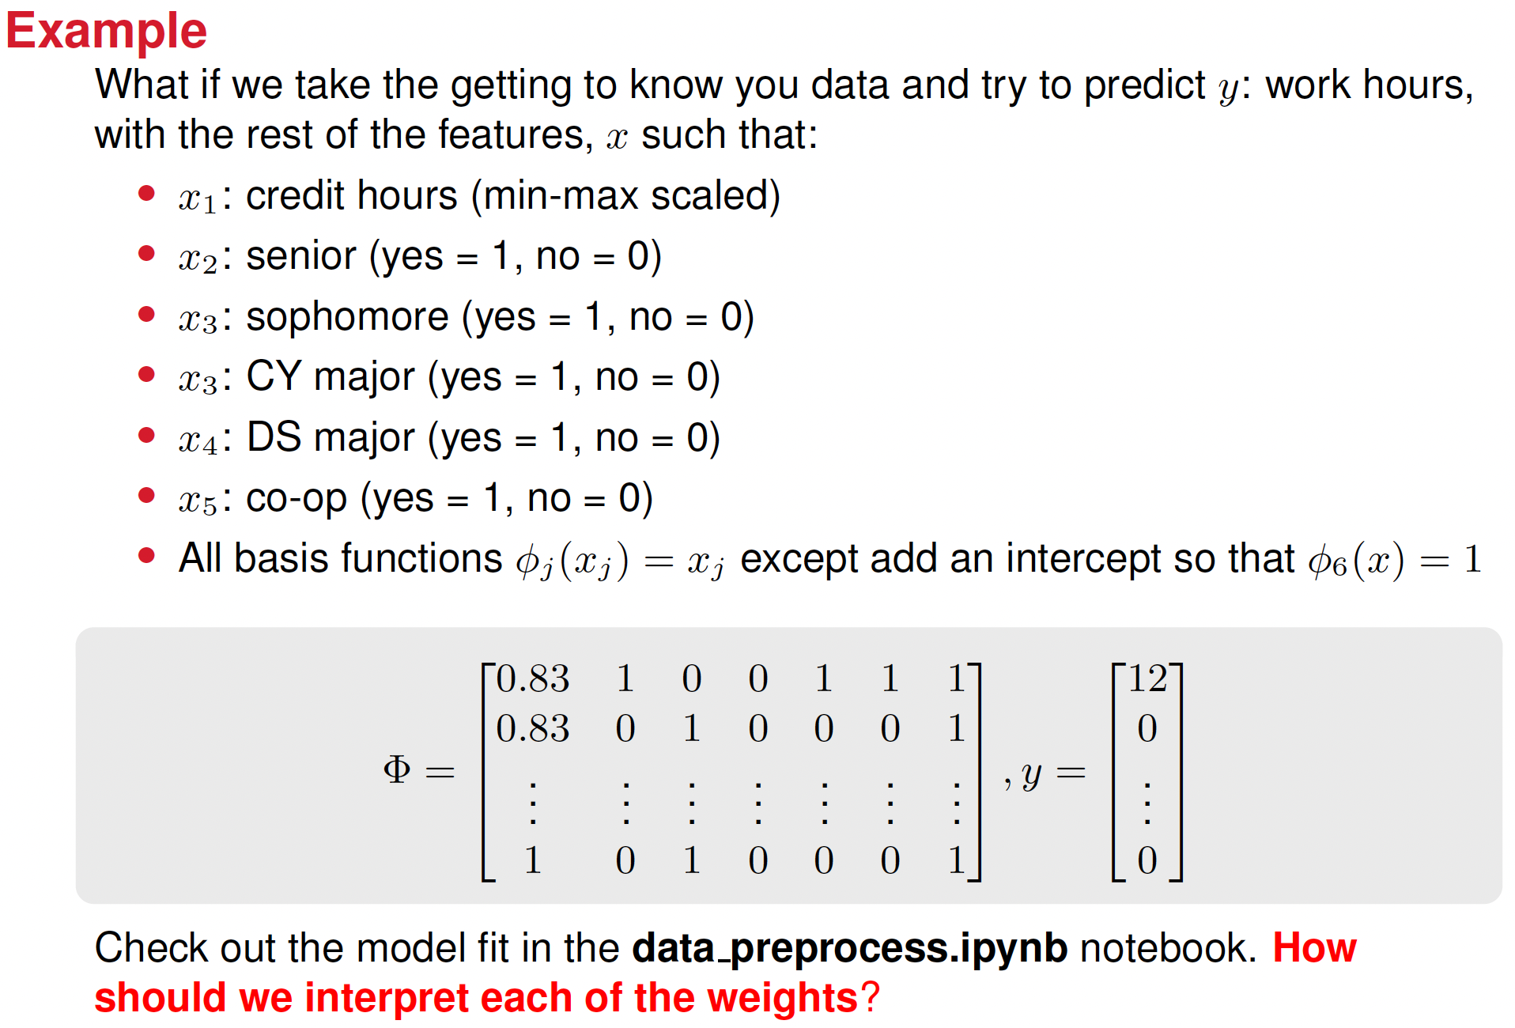

Slide 26
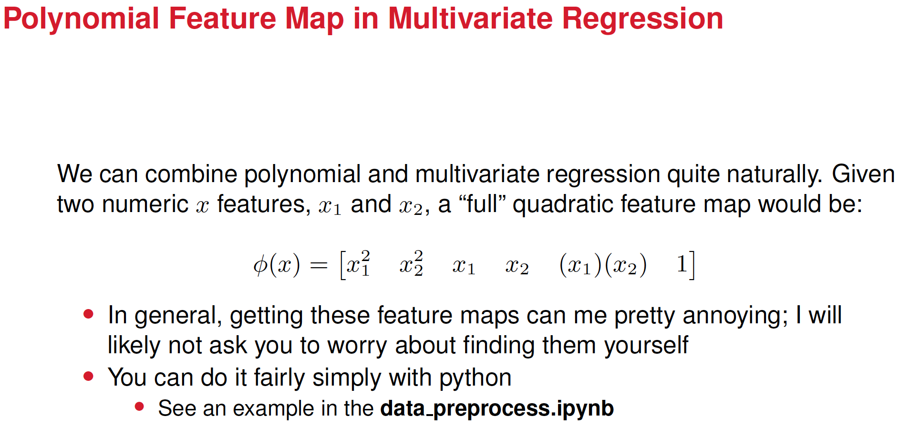

Slide 27
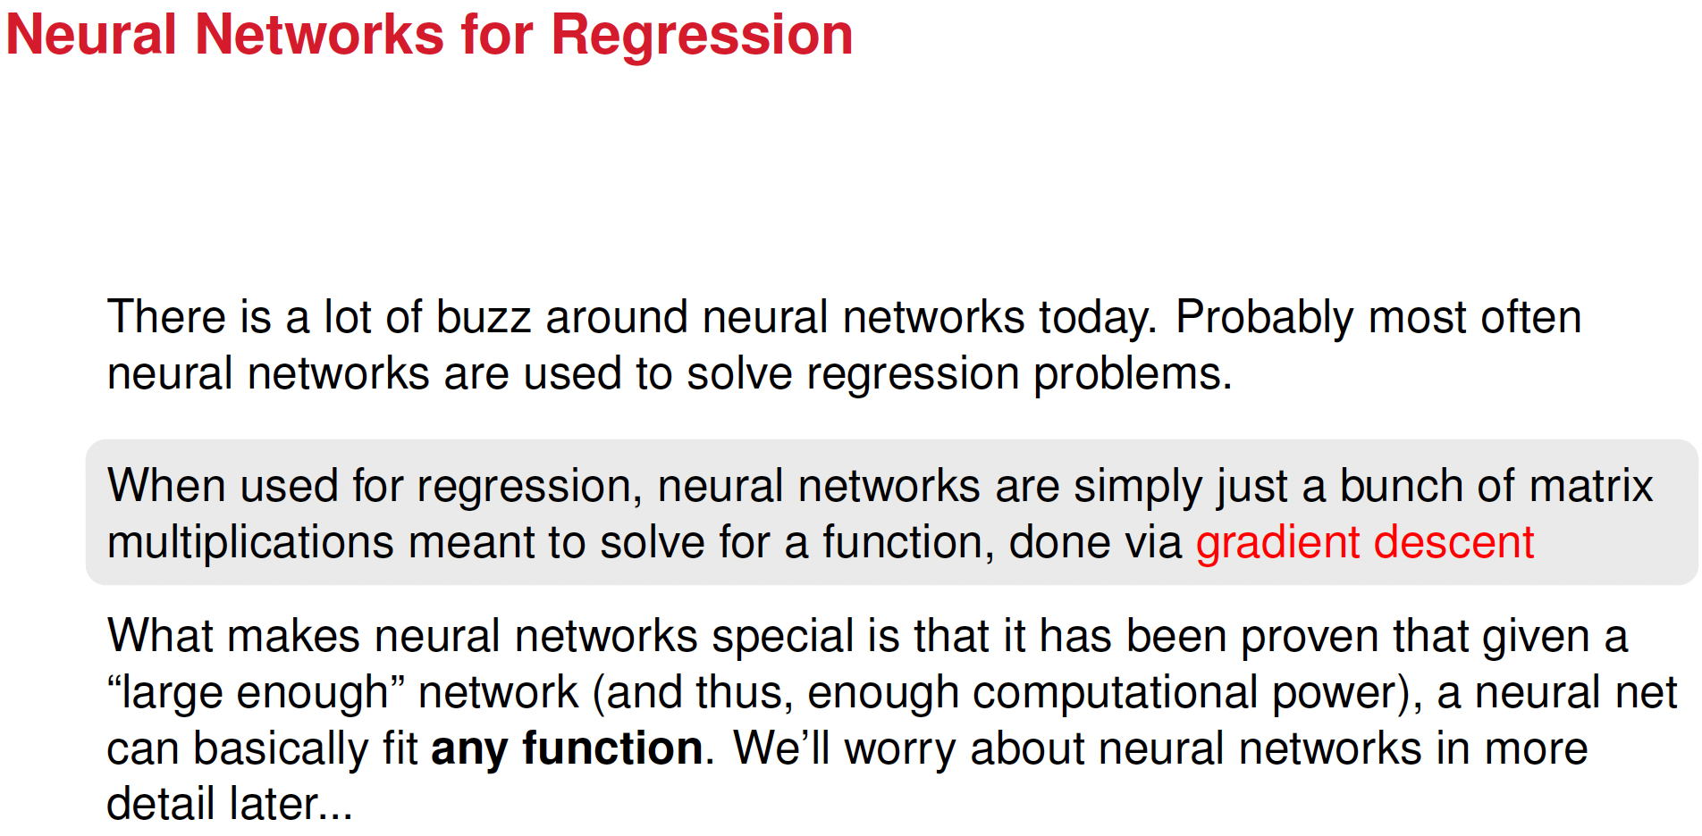

Slide 28
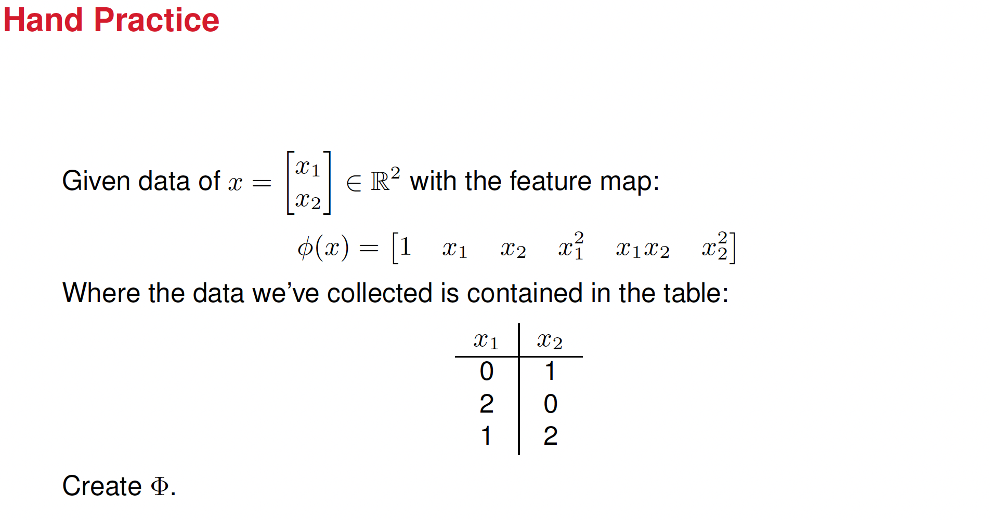

Slide 29
























Slide 30
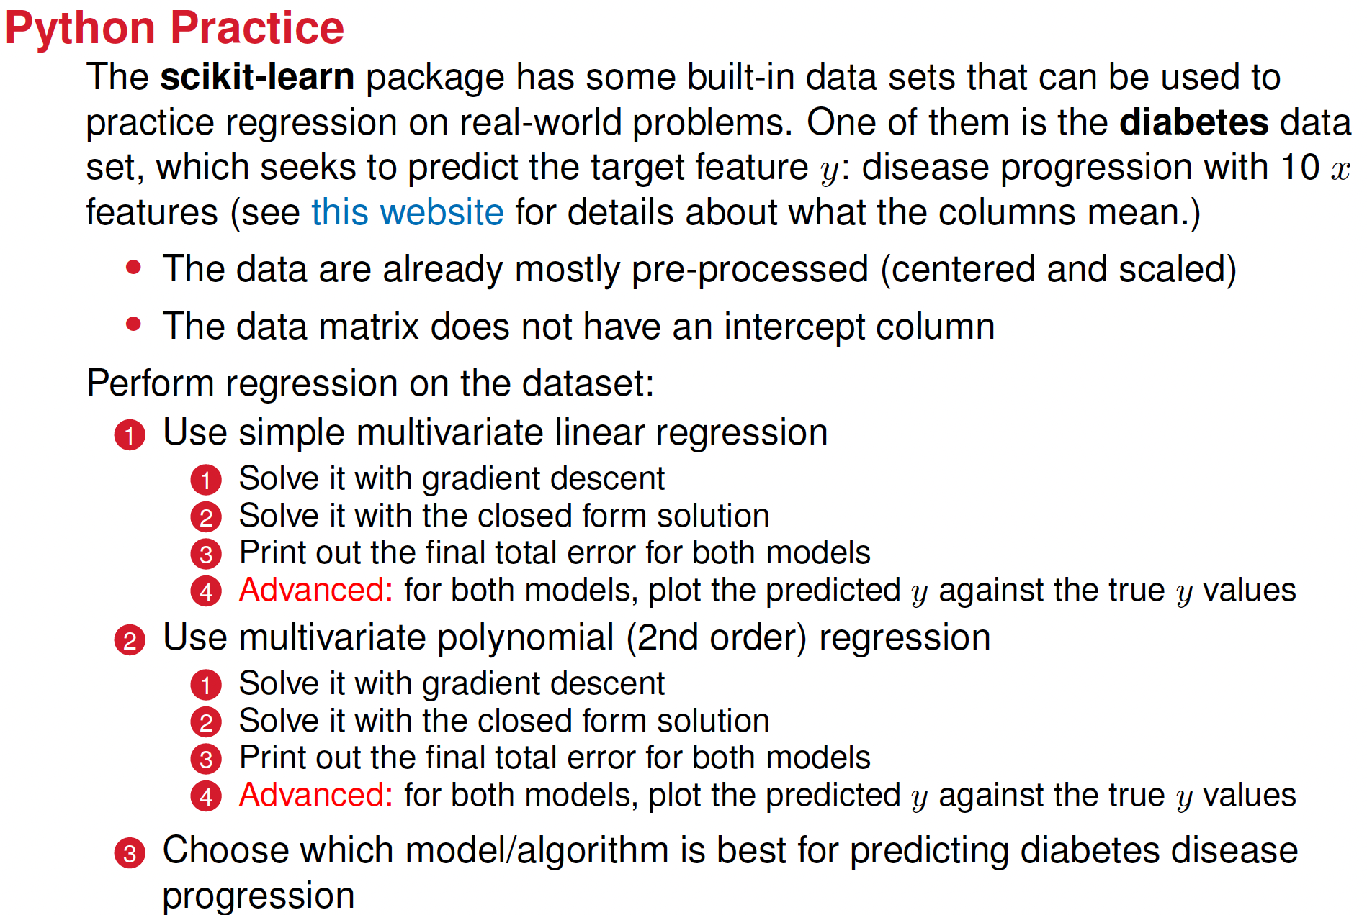

Slide 31
Review of material regarding regression
Loss function for the regression problem, univariate and multivariate.
Numerical solution: Steepest Gradient descent
Exact solution: closed-form solution aka Ordinary Least squares solution
Python implementation of both
Regularization: L1 and L2 norms
Python implementation of regularization in next lessons
Alternatives: Scikit-learn implementations

